Slide 1





BUILD YOUR BRAND
A Beginner’s Guide to Social Media Presence for Entrepreneurs

Slide 2
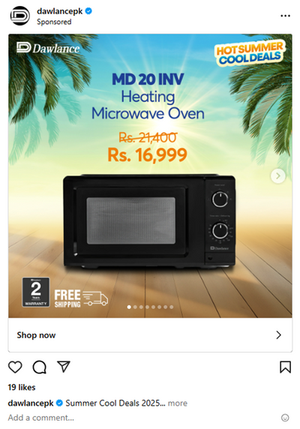
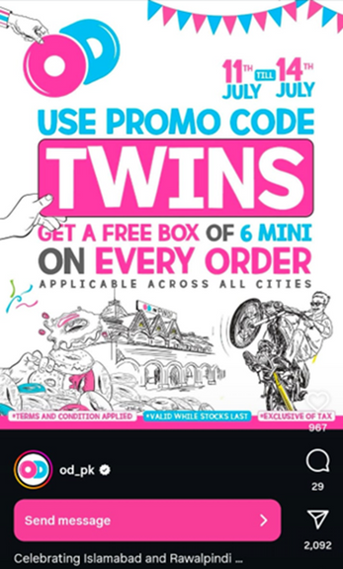
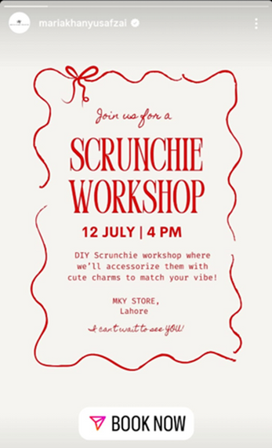
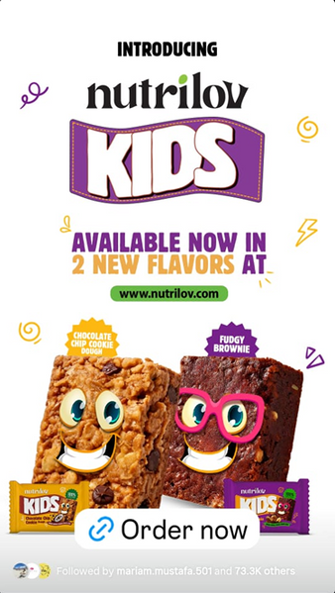

Paid ads

Slide 3

Paid ads
Need a credit or debit card for payments
Create a New Ad Account
Open settings in the Meta Business Suite business.facebook.com (desktop only)
Click Accounts → Ad Accounts → “Add” button → “Create a New Ad Account.”
Fill in details:
-Ad Account Name → e.g., "Kaib Bakery Ads“
-Time zone & currency (cannot be changed later)
-Assign yourself the role Admin so you can manage and run ads.
-Add a payment method (Master Card, Visa, Sadapay)
-Once done, you’ll see the ad account in your Meta Business Suite.
Notes:
Avoid audience overlap
Avoid auction overlap

Slide 4
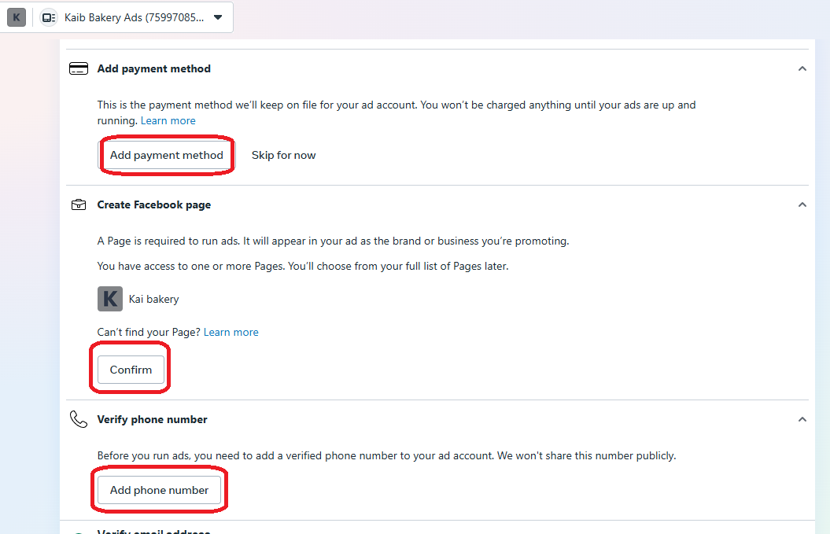
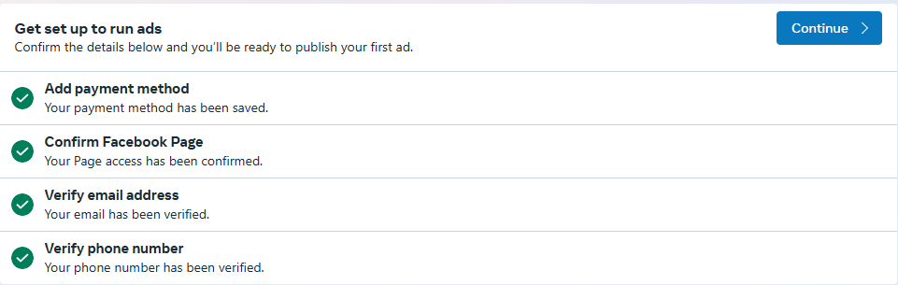
Paid ads
Add further details
Notes:
Avoid audience overlap
Avoid auction overlap

Slide 5
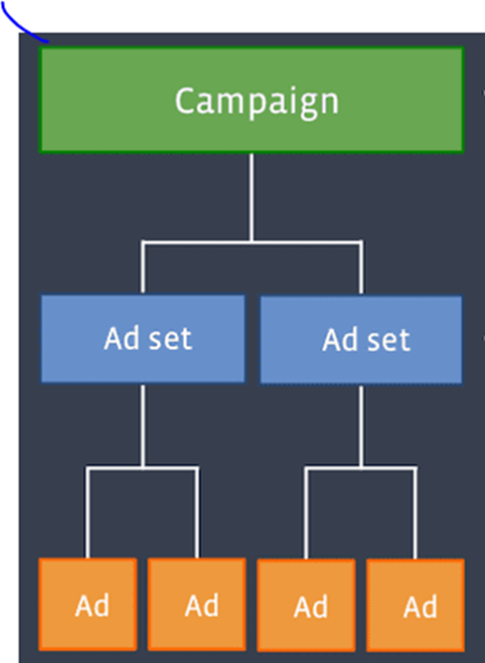
Paid ads
Download Meta Ads Manager from the App Store for the hands-on activities
Many deep asset assignments not possible on mobile app
Desktop: https://adsmanager.facebook.com/
Ads: Images, videos, text
Ad sets: has a collection of ads with the same settings
Campaigns: collection of ad sets with specific goal
Notes:
Avoid audience overlap
Avoid auction overlap

Slide 6
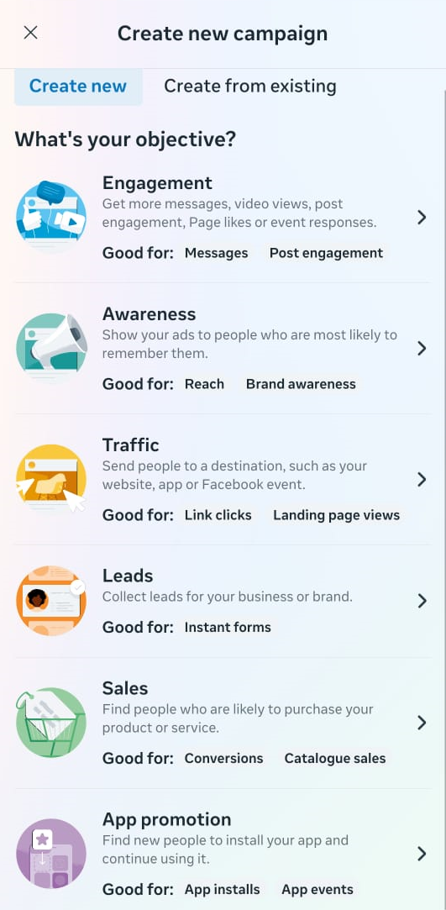
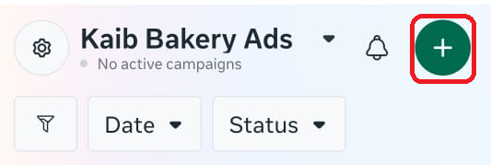
Paid ads
Objective | Best For | Conversion Intent | Cost per Result | Setup Difficulty
Awareness | Brand exposure | Low | Low | Easy
Traffic | Website visits | Medium | Medium | Easy
Engagement | Social proof, community growth or DMs or call | Medium | Low | Easy
Leads | Email/phone collection | High | Medium | Medium
App Promotion | App downloads | High | Medium-High | Medium
Sales | Online purchases | Very High | High | Harder (pixel needed)
Notes:
Avoid audience overlap
Avoid auction overlap

Slide 7
Paid ads
Audience Targeting
Two options: Automatic OR Create New Audience
Location, Age & Gender
Detailed Targeting: Interests / Behaviors / Demographics.
You may Save Audience → Toggle Save This Audience ON → Give it a name.
Use Custom/Lookalike Audiences (if customer list exists):
Can use previously saved audience
Notes:
Avoid audience overlap
Avoid auction overlap
Engagement: no website, increase likes engagement on post, algorithm will boost those posts and profiles. Or direct to DMs or WhatsApp or call
Leads: data collection, hiring, real estate
App promotion: perform action inside the app is of higher priority than installation
Sales: e-commerce store
Traffic vs sales: website, info or service or cooking website, landing page views. Sales is only for selling.

Slide 8
Paid ads
Creative & Ad Formats
Select Ad Creative → Select Media.
Choose Ad Format:
Single/Carousel
Reels / Stories → Tap Edit Placements → Instagram Reels / Facebook Stories (formats adjust automatically).
Write Primary Text + Headline + Call-to-Action (CTA button like “Shop Now” / “Learn More”).
Preview in Feed / Stories / Reels by swiping preview tabs.
Notes:
Avoid audience overlap
Avoid auction overlap
Engagement: no website, increase likes engagement on post, algorithm will boost those posts and profiles. Or direct to DMs or WhatsApp or call
Leads: data collection, hiring, real estate
App promotion: perform action inside the app is of higher priority than installation
Sales: e-commerce store
Traffic vs sales: website, info or service or cooking website, landing page views. Sales is only for selling.

Slide 9
Paid ads
Placement & Optimization
Select Placements: Automatic Placements OR Manual Placements
Facebook Feed, Instagram Feed, Stories, Reels, Marketplace, Right Column, In-stream Videos.
Tap Optimization & Delivery:
Optimization Goal: Choose Link Clicks / Landing Page Views / Conversions / Reach depending on objective
Budget & Schedule:
Select Daily Budget or Lifetime Budget
Enter amount
Tap Schedule → Start & End date
Notes:
Avoid audience overlap
Avoid auction overlap
Engagement: no website, increase likes engagement on post, algorithm will boost those posts and profiles. Or direct to DMs or WhatsApp or call
Leads: data collection, hiring, real estate
App promotion: perform action inside the app is of higher priority than installation
Sales: e-commerce store
Traffic vs sales: website, info or service or cooking website, landing page views. Sales is only for selling.

Slide 10
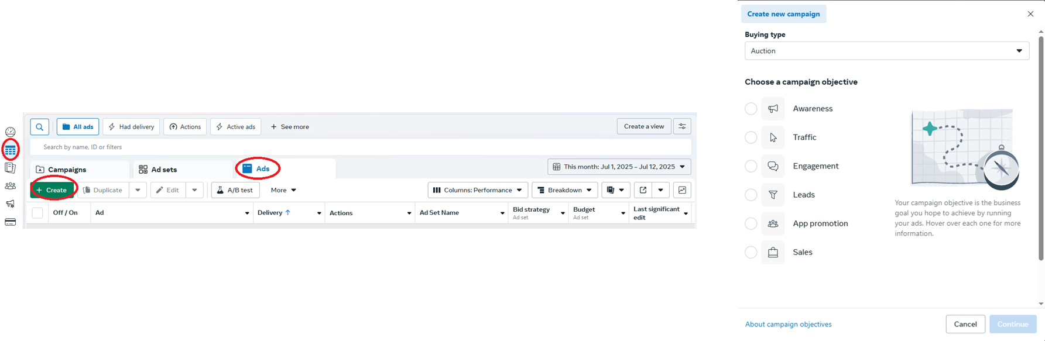
Paid ads
Click -> Campaign -> Ads
Auction > Reservation
Notes:
Avoid audience overlap
Avoid auction overlap

Slide 11
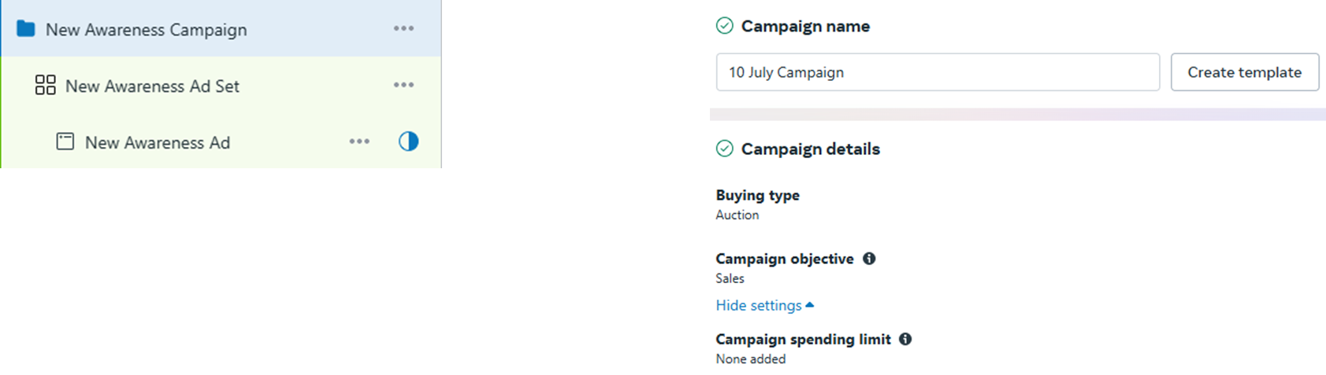
Paid ads
Notes:
Avoid audience overlap
Avoid auction overlap
Social issues: needs verification with Passport or CNIC to run such a campaign
Auction vs Reservation:
-Auction: competition, less cost, depends on how good the ad creative and ad copy is, along with budget
-Reservation: booking, pay more, reserve slot

Slide 12
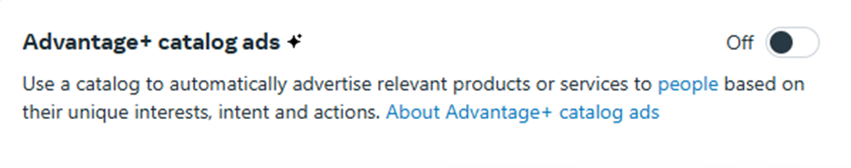
Paid ads
Best for:
Businesses selling multiple products
Those with a product catalog in Meta Commerce Manager
Websites with Meta Pixel or Conversions API installed
Brands wanting automated retargeting and personalized product ads
Criteria | Campaigns
Only1-2 services/items | Sales or Leads
No website/product catalog | Traffic or Engagement
Testing early-stage ad ideas | Simpler
Not needed if you have 1–2 products/services or don’t have a product catalog set up.
Notes:
Avoid audience overlap
Avoid auction overlap

Slide 13
Paid ads
Click -> Campaign -> Ads
Auction > Reservation
Notes:
Avoid audience overlap
Avoid auction overlap

Slide 14
Paid ads
Notes:
Avoid audience overlap
Avoid auction overlap
Social issues: needs verification with Passport or CNIC to run such a campaign
Auction vs Reservation:
-Auction: competition, less cost, depends on how good the ad creative and ad copy is, along with budget
-Reservation: booking, pay more, reserve slot

Slide 15
Paid ads
Best for:
Businesses selling multiple products
Those with a product catalog in Meta Commerce Manager
Websites with Meta Pixel or Conversions API installed
Brands wanting automated retargeting and personalized product ads
Criteria | Campaigns
Only1-2 services/items | Sales or Leads
No website/product catalog | Traffic or Engagement
Testing early-stage ad ideas | Simpler
Not needed if you have 1–2 products/services or don’t have a product catalog set up.
Notes:
Avoid audience overlap
Avoid auction overlap

Slide 16
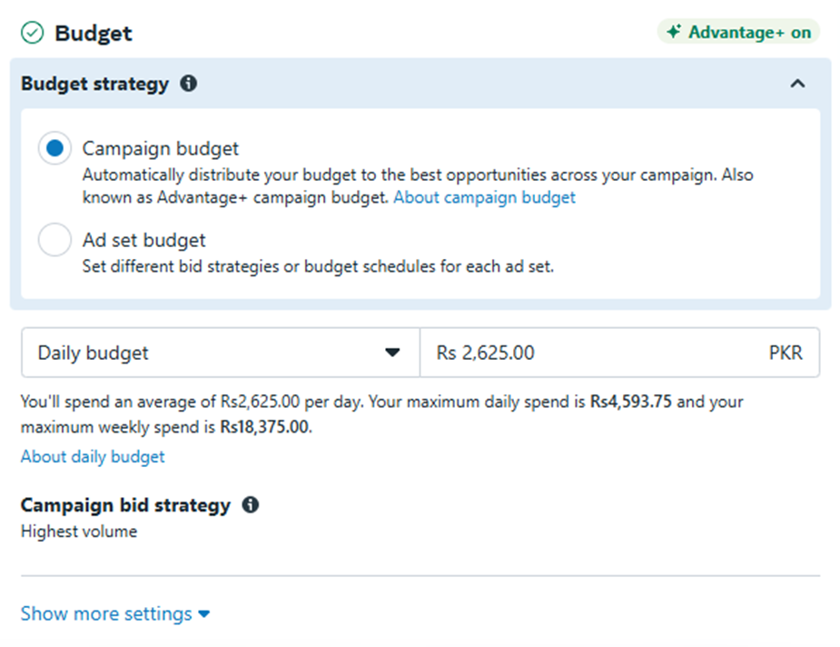
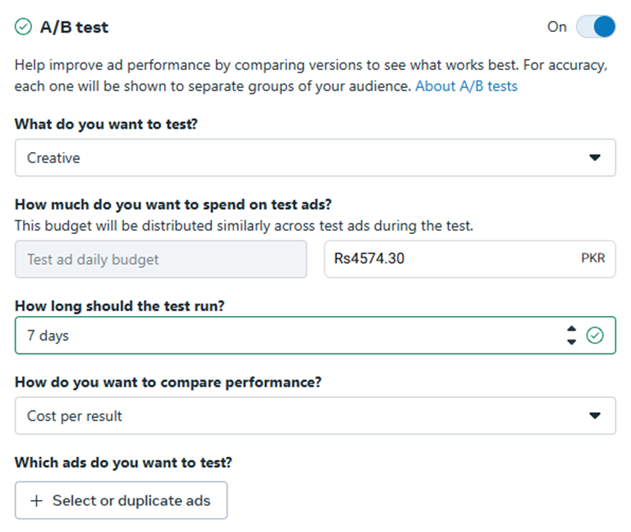
Paid ads
Notes:
Avoid audience overlap
Avoid auction overlap

Slide 17
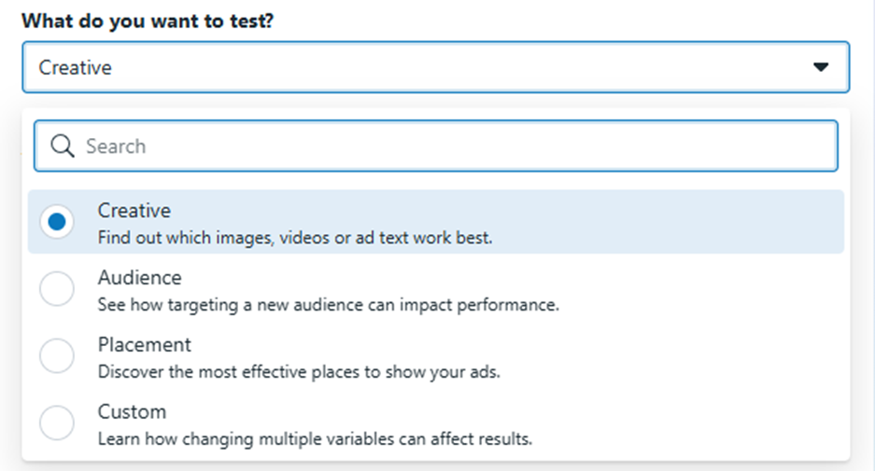
Paid ads
Notes:
Avoid audience overlap
Avoid auction overlap

Slide 18
Paid ads
Performance goals:
If your goal is “link clicks”, Meta will show your ad to people who often click on ads
Purpose
Removes ambiguity about what you want and make a realistic budget plan
Some goals (like purchases) cost more than others (like clicks).
Objective | Performance Goal
Get people to visit a website | Link Clicks Landing Page Views
Get more sales | Conversions
Get people to message | Conversations
Get video views | ThruPlay Views
Get calls | Calls
Get leads | Leads Leads through Messaging
Notes:
Avoid audience overlap
Avoid auction overlap

Slide 19
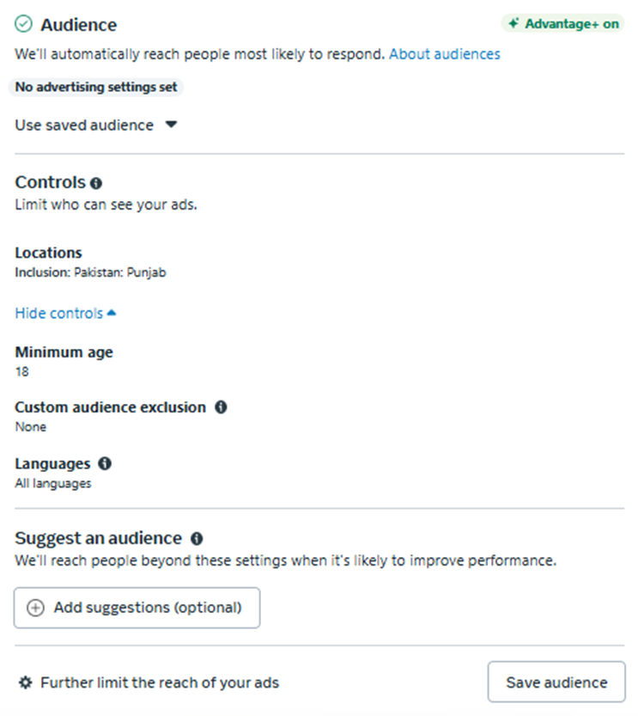
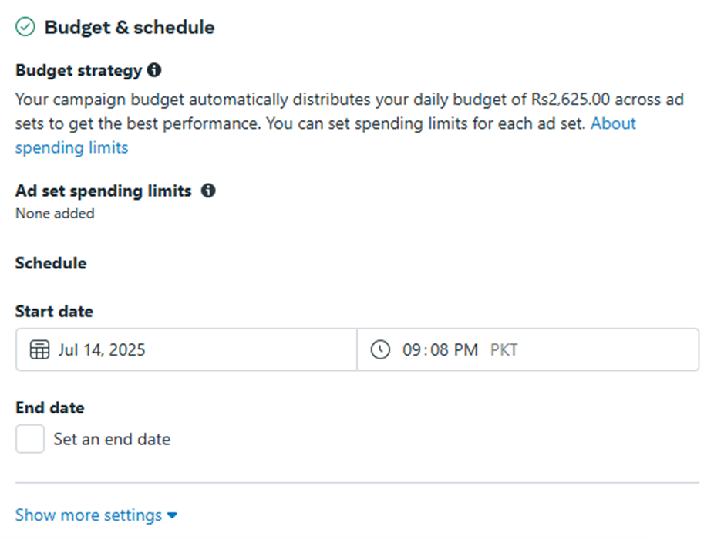
Paid ads
Look alike audience: Similar to your current audience
Increase chances of sales
Needs data to power this feature
Notes:
Avoid audience overlap
Avoid auction overlap

Slide 20
Paid ads
Awareness vs Engagement campaign
Traffic vs Sales campaign
Only difference in Ad sets: define performance goals for each objective
WhatsApp conversion rate is very high, but can go ahead with Instagram DMs and Messenger DMs as well
Notes:
Avoid audience overlap
Avoid auction overlap

Slide 21
Paid ads
Location: select specific city, specific societies, exclude specific societies
Age: depends on the product, buying power, buyer vs consumer eg toys, children’s clothes → buying persona → personal information + interaction history
Detailed audience targeting: demographics vs behaviors vs interest
Demographics: who they are on paper
Interests: what people engage with on Social Media apps
Behaviors: past actions, purchase behavior, device usage, and travel habits. It’s action-based targeting
Notes:
demographics:
Company size
Age 18–24, 25–34, etc.
Gender Men, Women, Education level High school, College grads, Master's, etc.
Job title / industry Engineer, Artist, Self-employed
Life events Recently moved, Just got married, Birthdays coming up
Relationship status Single, Married, In a relationship
Parents Parents with toddlers (1–2 years), New parents
Behaviors:
Hobbies(Cooking, Photography, Gardening)
Entertainment(K-dramas, Marvel, Netflix, Coke Studio)
Shopping(Online shoppers, Fashion lovers)
Fitness( Yoga, Running, Gyms)
Technology(Android, iPhone users, Gadgets)
Beauty & Fashion(Skincare, Makeup, Men’s fashion)
Food(Baking, Street food, Vegan cuisine)
Behaviors:
Purchase behavior(Engaged shoppers (clicked 'Shop Now'), High-value spenders)
Device use(iPhone 13 users, Android tablet users)
Travel behavior(Frequent international travelers, Commuters)
Page admins(Business page admins (great for B2B)
Engaged with ads(Clicked ads in the past 7 days)
Facebook payment users(Made in-app purchases before)

Slide 22

Scenario 1
Options
You are running ads for a brand that sells organic baby shampoo.
Demographic
Interest
Behavior
Notes:
Q: What’s the best targeting strategy?
(A) Parents of infants → ___?
(B) People who follow parenting blogs → ___?
(C) People who have recently shopped for baby items → ___?
Expected Answers:
(A) Demographic
(B) Interest
(C) Behavior

Slide 23
Scenario 2
Options
You’re promoting a burger shop offering discounts.
Demographic
Interest
Behavior
Notes:
Q: What would you use to target effectively?
(A) People who live near the shop → ___?
(B) People who follow food pages or food bloggers → ___?
(C) People who often use Facebook Offers → ___?
Expected Answers:
(A) Demographic (location)
(B) Interest
(C) Behavior

Slide 24
Scenario 3
Options
You are selling birthday gifts
Demographic
Interest
Behavior
Notes:
-Anniersary
-Friends of men with birthday in 0 -7 days

Slide 25
Paid ads
Dynamic ads that automatically show the most relevant products from your catalog to each user based on their behavior (like views, add-to-cart, or past purchases).
Best for:
Businesses selling multiple products
Those with a product catalog in Meta Commerce Manager
Websites with Meta Pixel or Conversions API installed
Brands wanting automated retargeting and personalized product ads
Notes:
Avoid audience overlap
Avoid auction overlap

Slide 26
Paid ads
KPIs to measure result of each campaign
CPM: Cost Per Milestone (10,000 impressions)
CPC: Cost Per click
CTR: Click Through Rate (10 people clicked over 100) = 10%
Reach: Unique
Impression: One person can see the same add multiple times
Ad frequency: impressions / reach
CPL: Cost Per Lead
Conversion rate: purchased/ clicked
CPV: Cost Per View
ROI: Return on Investment
ROAS: Return on Ad Spent
Notes:
Avoid audience overlap
Avoid auction overlap

Slide 27
Paid ads
KPIs to measure result of each campaign
CPM: Cost Per Mille (10,000 impressions)
CPM = (Total Spend/Total Impressions)×1000
CPC: Cost Per Click
CPC= Total Spend​ / Total Clicks
CTR: Click Through Rate, the % of people who clicked your ad after seeing it.
CTR= (Clicks/Impressions)×100
Reach: the number of unique people who saw your ad at least once.
Impression: The total number of times your ad was displayed, including multiple times to the same person.
Notes:
Avoid audience overlap
Avoid auction overlap

Slide 28
Paid ads
KPIs to measure result of each campaign
Ad frequency: the average number of times each person saw your ad.
Ad frequency=Impressions/Reach
CPL: Cost Per Lead, the cost you pay to get one lead (signup, form fill, etc.).
CPL=Total Spend/Number of Leads
Conversion rate: (purchased/ clicked) x 100
CPV: Cost Per View (Videos)
CPV= Total Spend/Video Views
Notes:
Avoid audience overlap
Avoid auction overlap

Slide 29
Paid ads
KPIs to measure result of each campaign
ROI: Return on Investment
ROI= (Net Profit/ Cost of Investment) ​× 100
ROAS: Return on Ad Spent
ROAS=(Ad Spend / Revenue from Ads​) x 100
Notes:
Avoid audience overlap
Avoid auction overlap

Slide 30
Paid ads
Always compare your results to
Past campaign performance
Industry averages
Campaign goal (cheap awareness ≠ high ROAS)
Campaign Type | Key KPIs to Watch | Good Result Means…
Awareness | CPM, Reach, Frequency | You’re getting cheap reach, not spamming same people too much
Traffic | CPC, CTR | People are clicking your ad at low cost
Engagement | CTR, Likes, Comments, Shares | People are interacting with your content
Leads | CPL, Conversion Rate | Leads are coming in at a good cost
Sales | ROAS, Conversion Rate, CPC | You're getting profitable purchases
Notes:
Avoid audience overlap
Avoid auction overlap

Slide 31
Paid ads
Can do manual testing
Campaign needs to be published for A/B testing
Notes:
Avoid audience overlap
Avoid auction overlap

Slide 32
4
Social Media Content Types

Slide 33

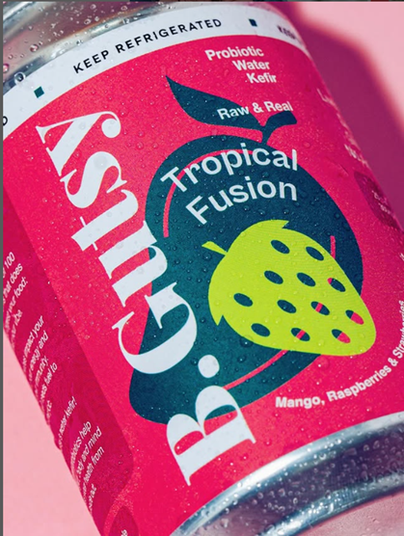
POST
Purpose: Show your product, promotions, testimonials, or tips.
Stay permanently on your profile grid.
Notes:
Post: A regular image, video, or carousel (multiple images) that you share on your profile.
Story: A short video or photo that stays visible for 24 hours only. Often used for behind-the-scenes, updates, and casual interaction.

Slide 34
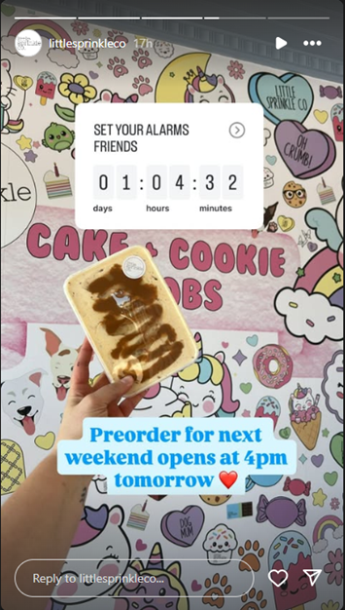
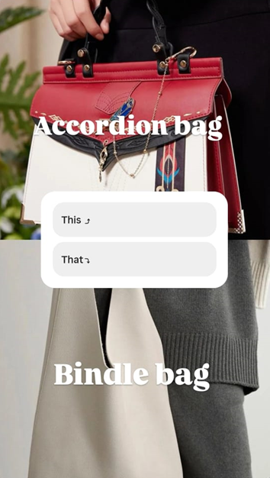

STORY
Features: Polls, questions, countdowns, music, tagging
Stories show up at the top of Instagram/Facebook when someone opens the app.
Notes:
Post: A regular image, video, or carousel (multiple images) that you share on your profile.
Story: A short video or photo that stays visible for 24 hours only. Often used for behind-the-scenes, updates, and casual interaction.

Slide 35
REEL
Hashtag
Best way to reach non-followers.
Reels appear on Explore pages and bring new traffic to your account.
Intended to go viral -> people to your page
# Organize content & reach new audiences
2–3 popular + 2–3 niche/local ones
Stories: behind-the-scenes, polls
Lives: Q&A session teasers or product demos
Hashtags with 10K–500K posts are better than those with millions (less competition, more targeted)
Notes:
Reel: A short, vertical video (up to 90 seconds) with music, filters, or captions—made to entertain and go viral.
Hashtag: A clickable keyword (with # symbol) that helps people discover your posts.

Slide 36
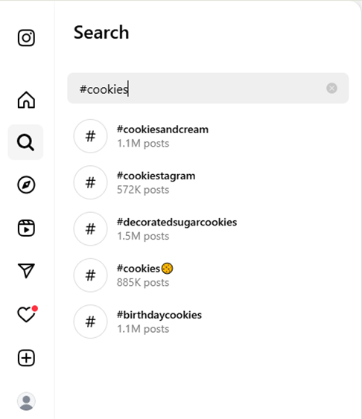
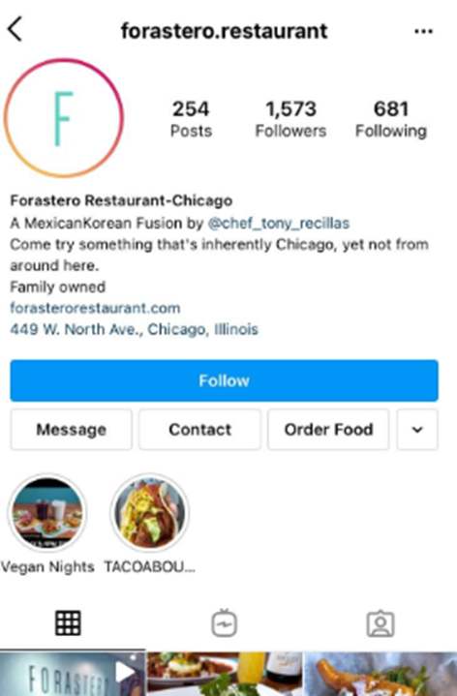
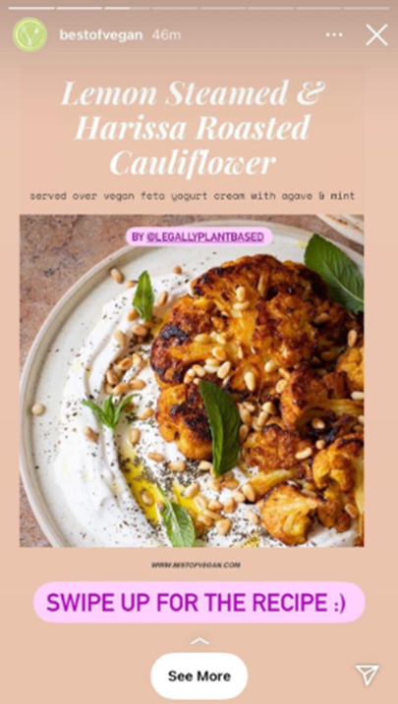
Hashtag
Call to Action buttons
Swipe up

Slide 37
DM
Engagement
Most local businesses in Pakistan take orders via DM.
More engagement = more reach = more potential customers
Example:
Ask questions in stories
Polls in stories
This or That quizzes
Always reply politely, and you can use Quick Replies on Instagram Business accounts.
Algorithm
Link in Bio
The system that decides who sees your content and how often.
WhatsApp, Linktree, Shopify, Website
Notes:
DM: A private message someone sends you via Instagram or Facebook.
Engagement: Any action a follower takes on your content—likes, shares, saves, comments, clicks, replies.

Slide 38
End of Class

